Slide 2
Binghamton University EngiNet™ State University of New York

Slide 3
Thomas J. Watson School of Engineering and Applied Science

Slide 4
WARNING All rights reserved. No part of the course materials used in the instruction of this course may be reproduced in any form or by any electronic or mechanical means, including the use of information storage and retrieval systems, without written approval from the copyright owner. ©2017 International Business Machines ©2017 Binghamton University

Slide 5
New Course CS580Z/CS480Z (Fall, 2017) (Tuesday’s and Thursday’s 11:40 to 01:05) Introuction to The Mainframe: z/VM Basics Lecture 21 November 9th, 2017
Faculty : Brian Hugenbruch, Merwyn Jones
IBM z/VM Lab Development team
( http://www.vm.ibm.com/ )

Slide 6
Introduction to Virtualization Security Using z/VM as an Illustrated Guide
Brian W. Hugenbruch, CISSP IBM Z Security for Virtualization & Cloud
Last updated 31 October 2017

Slide 7


z Virtualization is increasingly in the middle of bigger things.
Guest
Guest
Guest
Guest
Your zVM USERID
SVM
SVM
SVM
…
z/VM
PR/SM (one z System Logical Partition)
CPACF
OSA
Crypto Express
z14
Notes:
This is more than a little ironic, because z Systems is growing by leaps and bounds into new technologies. Mainframe administrators are fond of saying that they were doing "cloud" before it became a thing, and they're partially right – provisioning, tenancy, scalability are all capabilities that make z unique for hosting clouds of any stripe or sort. [Note for zSummit presenters: there's a good chance your audience has spent most of the day hearing about just this very thing.]

Slide 8
What is Virtualization Security?
Virtualization security is a set of mechanisms
through which
the availability, integrity, and confidentiality of
virtualized assets (e.g., resources, services, and data)
are preserved and protected
against potential threats.

Slide 9
What is Virtualization?
A mechanism through which the real system memory and resources can be shared amongst multiple competing execution contexts.
The purpose of z/VM is to virtualize the real hardware:
Faithfully replicate the mainframe hardware architecture
Permit any virtual configuration that could legitimately exist in real hardware
Let many virtual machines operate simultaneously
Allow overcommittment of the real hardware (processors, for example)
CMS
CMS
Linux
z/VSE
z/OS
CP
z/VM Control Program (CP)

Slide 10
Our focus today is virtualization security.
Guest
Guest
Guest
Guest
Your zVM USERID
SVM
SVM
SVM
…
z/VM
PR/SM (one z Systems Logical Partition)
CPACF
OSA
CryptoExpress
z14
10

Slide 11
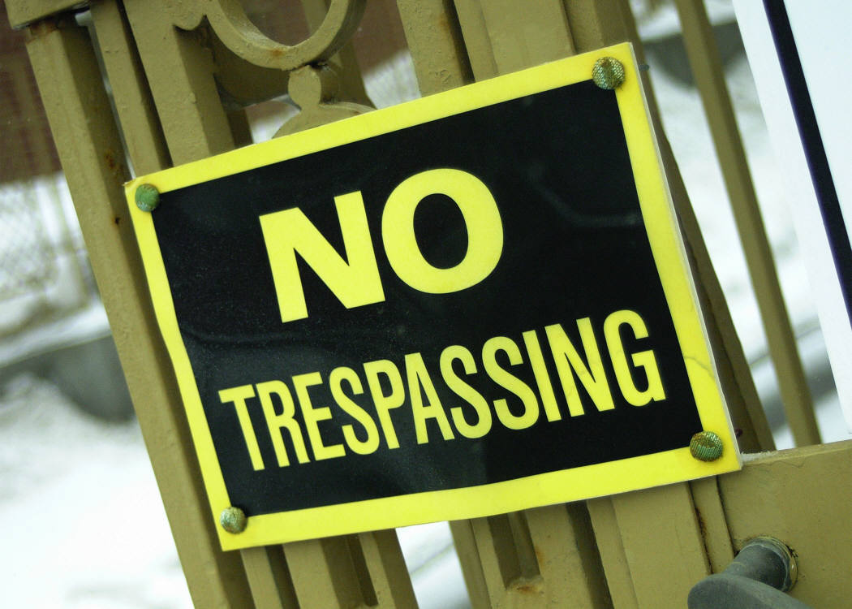
What is Security?
Access control?
Cryptography?
Managing your networks?
Disaster recovery?
Conforming to laws and regulations?
Auditing policies?
“Guarding what isn’t bolted down?”
Security is:
a broad topic covering a lot of different disciplines
subject to increased scrutiny by governments and businesses
increasingly important in today’s technology discussions

Slide 12
What is Security?
Availability
the guarantee that information, systems and resources are accessible to users in a timely manner
Integrity
the guarantee that information is accurate, complete and protected from unauthorized modification.
Confidentiality
the guarantee that information is not disclosed to unauthorized individuals, programs, or processes.

Slide 13
Vulnerabilities, Threats, and Risk
Threat
Any potential danger to information or systems.
exploits …
Vulnerability
A weakness in an information system (software, hardware, or procedural).
leads to …
Risk
The likelihood of someone exploiting a vulnerability, with corresponding impacts to business.
can damage …
Assets
Data, services, systems. In our case, the z/VM system, its virtual machines, disk, data, and networks.
and cause an …
Exposure
The result of a vulnerability being exploited – e.g., damaged assets, disrupted business, legal action.

Slide 14

What are the risks to a virtualized environment? *(An example list from the PCI DSS v2 standard)
Vulnerabilities in the Physical Environment Apply in a Virtual Environment
Hypervisor Creates a New Attack Surface
Increased Complexity of Virtualized Systems and Networks
More than One Function per Physical System
Mixing VMs of Different Trust Levels
Lack of Separation of Duties
Dormant Virtual Machines
VM Images and Snapshots
Immaturity of Monitoring Solutions
Information Leakage between Virtual Network Segments
Information Leakage between Virtual Components

Slide 15
What is Virtualization Security?
Virtualization security is a set of mechanisms
through which
the availability, integrity, and confidentiality of
virtualized assets (e.g., resources, services, and data)
are preserved and protected
against potential threats.

Slide 16
What is Security?
Q: How does z/VM work toward high Availability?
Extensive testing and debugging over 40+ years as a product have produced a stable environment for “mission-critical” hardware
Graceful failure. If something breaks, the errors are isolated and contained.
Syntactical and semantic checking of commands
Easy to re-IPL
Separation of virtual machines
The goal of five 9’s

Slide 17
What is Security?
Q: What does Integrity mean to z/VM?
The ability of the hypervisor (CP) to operate without interference or harm, intentional or not, from the guest virtual machines
The inability of a virtual machine to circumvent system security features and access controls
The ability of the hypervisor to protect virtual machines from each other
Q: So, how do we accomplish all this?

Slide 18
Interpretive Execution Facility
Start Interpretive Execution (SIE) instruction describes a virtual machine
Registers, PSWs, memory
Interception conditions (a.k.a. "SIE break")
Time slice expires
Unassisted I/O
Instructions that require CP’s help
e.g. Set Clock
Certain program interrupts
SIE runs until interception condition raised
To a virtual machine, “real” is a virtual reality created by the underlying hypervisor

Slide 19
Hardware Access to Virtual Memory
SIE uses dynamic address translation to convert virtual addresses to real addresses.
CP provides page, segment, and region tables to SIE
Page table entries are ‘invalid’ until initialized by CP
CP Real Memory

Slide 20
Interpretive Execution Facility
SVM
SVM
Guest
Your Second-level System
Guest
Guest
Guest
Your zVM USERID
SVM
SVM
SVM
…
z/VM
Provides not one, but two levels of hardware support for virtualization
Level 3+ “pancakes” down to Level 2
SIE is always used to run a virtual machine, no matter how “high up”
Level 2 runs a virtual machine within a z/VM LPAR
Level 1 runs the LPAR
PR/SM (one z Systems Logical Partition)
CPACF
OSA
CryptoExpress

Slide 21
Virtual I/O
SIE break – CP examines I/O request
Translates CCW virtual addresses to real addresses
Pins user pages in memory
Looks for harmful operations
Alters minidisk cylinder locations, if required
Inserts device limits whenever possible
DEFINE EXTENT for minidisks
Real cylinder
Virtual Cylinder
301-400
0-99
LABEL4
201-300
0-99
LABEL3
101-200
0-99
LABEL2
1-100
0-99
LABEL1
0
630WRK

Slide 22

Security and Integrity
System security is only meaningful in the presence of system integrity!
Audit trail confirms conformance
Integrity prevents bypass of security controls
If a virtual machine can touch real memory, it can do whatever it wants.

Slide 23
What is Security?
Q: How do we manage Confidentiality in z/VM?
A: In three words:
Authentication
Authorization
Auditing

Slide 24

What is Security?
Authentication
Identification is, for example, asking for a userid or log-on name
Authentication is the confirmation of the identity presented – in other words, guaranteeing that you are who you say you are

Slide 25
What is Security?
Authentication
Several ways of authenticating a user:
what a person has (digital certificate, swipe card)
what a person knows (password, passphrase or PIN)
what a person is (fingerprints, biometric data)
Can use combinations of the above
“strong authentication” or “multi-factor authorization”
z/VM virtual machines and mechanisms use a password and/or a passphrase (“what you know”)
Logon processing, FTP, REXEC, NFS

Slide 26
What is Security?
Authentication in z/VM
About your passwords …
up to 8 alphanumeric characters
stored in clear text in USER DIRECT
obfuscated in the object directory
an External Security Manager (ESM) provides for secure, encrypted passwords
An ESM is required to use password phrase support in z/VM:
up to 100 characters
case sensitive
special characters and blanks

Slide 27
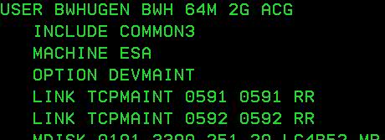
Defending a Single Virtual Machine
Authorization in z/VM
A user, once authenticated, should only have access to system resources which are within scope of responsibility or have been specifically granted
This applies to commands, interfaces, devices, and data
The privilege class is your first line of protection
Each user is assigned one or more privilege classes
The default for a general user is G
Defines what commands and DIAGNOSE functions the userid can issue
QUERY COMMANDS

Slide 28
Defending a Single Virtual Machine
… for four kinds of virtual machines:
General user: Class G authority or less.
Privileged user: any user with more than Class G authority.
Trusted server: a virtual machine with high authority which is important to system functionality (e.g., TCPIP). Runs disconnected.
System Operator: very privileged, but not necessarily trusted!
There are seven* IBM-defined Privilege Classes …
A: System Operators
B: System Resource Operators
C: System Programmers
D: Spooling Operator
E: System Analyst
F: Service Representative
G: General User
ANY: Commands available to anyone.
The capabilities of a virtual machine can therefore be defined based upon the role or roles it is expected to carry out (Role-Based Access Control).

Slide 29
Virtual Machines and Authorization
Guest
Guest
Guest
LINUX01
CP SHUTDOWN
SVM
SVM
…
z/VM
Authorization
But not all machines are created equal!
For virtual machines, their scope of responsibility should include just enough privilege to do their jobs.
If a virtual machine breaks security policy by doing something more powerful than it should, this is called an escalation of privilege.
PR/SM (one z Systems Logical Partition)
CPACF
OSA
CryptoExpress

Slide 30
Defending a Single Virtual Machine
But sometimes a Privclass has more power than we want to grant to a single virtual machine.
Class G has over 60 commands, not including the QUERY, DEFINE and SET parameters.
Very few of these are required for the IPL of a Linux guest.
Does a class G user really need QUERY NAMES?
(See “Less Than Class G”, available on an internet near you.)
Likewise, giving a new Privclass to a user, especially for one command, can lead to disastrous consequences.
The FOR and SEND commands are Class C.
But so is the STORE HOST command.
Excess privilege is the root of all evil.

Slide 31
Defending a Single Virtual Machine
So what options are available?
Local modification – SET PRIVCLASS (Class ANY and Class C)
Remove class authority from inside a virtual machine.
SET PRIVCLASS * -AC
But be careful; the Class C version can exceed directory-granted privilege!
Global modification – MODIFY CMD and MODIFY DIAGNOSE (Class A)
Dynamically redefine a command into a different privilege class.
MODIFY COMMAND SHUTDOWN PRIVCLASS S
MODIFY COM XAUTOLOG IBMCLASS A PRIVCLASS OUX
MODIFY CMD QUERY SUBCMD NAMES IBMCLASS G PRIVCLASS Z
MODIFY COMMAND XAUTOLOG RESET
MODIFY DIAG 94 PRIVCLASS V
No IBMCLASS functionality for MODIFY DIAGNOSE

Slide 32
Defending a Single Virtual Machine
Defining new privilege classes … some quick thoughts:
Can be associated with letters I-Z, and numbers 1-6
Can contain both IBM commands and locally created commands
Consider associating the new privclass with certain system roles
Helps to coordinate with regulations, certifications and laws
While redefining a command to Class Z (for example) can be an easy way to isolate a particular command, one could quickly lose track of what commands belong in which class and why
User-defined privilege classes won’t automatically gain new capabilities in a new release of z/VM

Slide 33
Defending a Single Virtual Machine
Be mindful of default passwords in the z/VM User Directory.
USER HUGEN2 HUGEN2 32M 32M G
ACCOUNT SYSTEMS
MACH XA
IPL CMS
CONSOLE 009 3215
SPOOL 00C 2540 READER *
SPOOL 00D 2540 PUNCH A
SPOOL 00E 1403 A
LINK MAINT 0190 0190 RR
LINK MAINT 019E 019E RR
MDISK 191 3390 1535 001 620RES MR READ WRITE MULTI

Slide 34
Defending a Single Virtual Machine
LOGONBY User Directory Statement
Allows the logging on of a virtual machine with another user’s credentials
LOGON OPERATOR by BWHUGEN
BWHUGEN’s password is entered instead of OPERATOR’s
Instead of sharing a single userid/password among multiple administrators, this provides accountability.
To require LOGONBY access for a userid, the USER statement must be modified:
>>-User--userid---+-password-+------------------------------->
+-NOLOG----+
+-NOPASS---+
+-AUTOONLY-+
'-LBYONLY--'
To grant LOGONBY access to other users, the LOGONBY statement must be added:
USER OPERATOR LBYONLY
...
LOGONBY BWHUGEN MERWYN MROSATO
Notes:
In ESM terms, this would be the SURROGAT class. In base CP, up to eight userids are allowed access for LOGONBY.

Slide 35
Defending CP
SYSTEM CONFIG is to z/VM as a user directory entry is to a single virtual machine. It contains multiple statements which can define and enhance security at CP initialization time.
ENABLE / DISABLE / MODIFY COMMAND or DIAGNOSE. The static way to make system-wide privclass-related changes to available functionality.
ALTERNATE OPERATOR: define specific userids who can become system operator if OPERATOR is shut down.
PRIV_CLASSES statement: redefine privilege class(es) necessary for certain functions: IOCP_READ, IOCP_WRITE, OPERATOR, USER_DEFAULT, HW_SERVICE
FEATURES:
PASSWORDS_ON_CMDS
ENABLE/DISABLE CLEAR TDISK
ENABLE/DISABLE SET_PRIVCLASS

Slide 36
z/VM Virtual Switch – VLAN aware
Linux
z/VM TCP/IP
VSE
z/OS
Virtual QDIO adapter
Virtual Switch Guest LAN
CP
OSA-Express
IEEE 802.1q transparent bridge
Multiple LANs
Ethernet LAN
Trunk port

Slide 37
Security controls on the VSWITCH
VMLAN LIMIT TRANSIENT 0
Prevent a virtual machine from creating dynamic (uncontrolled) LANs
Virtual Sniffers
Guest must be authorized via SET VSWITCH or security server
Guest enables promiscuous mode using CP SET NIC or via device driver controls
E.g. tcpdump -P
Guest receives copies of all frames sent or received for authorized VLANs
Port Isolation
Stop guests from talking to each other, even when in same VLAN
Shut off OSA “short circuit” to other sharers
Mind your HiperSockets
They are another LAN segment. Treat them like one!
Access lists
Not all guests can access a VSWITCH by default ….

Slide 38
Protecting Data At Rest: File Systems
Shared File System (SFS) – a more hierarchical file structure which makes use of available filepools in CMS.
Users must first be enrolled into a filepool
SFS directories can be accessed at an open filemode, if permissions are granted.
GRANT AUTHORITY <filename> <dirid> TO <user/Public> ( <level>
<level>: Read, Newread, Write, Newwrite, DIRRead, DIRWrite.
Byte-File System (BFS) – an OpenExtensions implementation based on Unix/Linux models. A special subset of filepool operations.
Users must be enrolled into the filepool in order to gain access. Posix membership must also be entered in the User Directory.
Access can be granted by owners to directories or files through use of chmod or openvm permit
File Systems and ESMs:
An External Security manager may maintain a greater list of access controls, either on a general basis (profiles) or as a discrete list (DAC checking).

Slide 39
Virtual Machines and Auditing
SVM
SVM
…
z/VM
But let’s say you’ve done all this …
Defined what security means
Configured your system properly
Managed your virtual machines’ capabilities
Controlled logon authority and password rules
… what happens when we ask you to prove it?
PR/SM (one z Systems Logical Partition)
CPACF
OSA
CryptoExpress

Slide 40
Auditing z/VM
Auditing is the assessment of a system’s internal control
Provides proof that your system is being operated according to your security policy
It is the most important data asset
How do you know that your business data has not had unauthorized updates?
How do you know if someone has accessed data for which they were unauthorized?
How do you tell which userid issued that SHUTDOWN command?

Slide 41
Reinforcing the Walls: ACI and ESMs
So what does an ESM provide, that Native CP does not?
Auditing – lots of auditing.
Enhanced control of certain commands (STORE HOST, FOR …)
Control of system resources (VLANs, VSWITCHes, Minidisks, NSSes, shared memory …)
Configurable overrides for Native CP security commands
DAC and MAC controls (a little more on this in a moment)
Stronger and more flexible password management (and password phrases)
Obfuscated and encrypted
100 characters for password phrases, plus special characters
Password policy management

Slide 42
Reinforcing the Walls: ACI and ESMs
ESM Virtual Machine
The ACI (Access Control Interface) is the control block CP uses to interact with a given external security manager. Installing an ESM replaces CP stub files with modifications that the ESM can understand.
It is through this interface that CP can validate the activity being processed with the rules, roles and labels programmed into the security manager in use.
When the ACI is accessed in order to confirm authority, the ESM can return one of three possible answers:
“Authorization granted.”
“Defer security decision to Native CP.”
“Authorization denied.”
Commands
Functions
DIAGNOSE instructions
CP ACI
ESM CP kernel extensions
*RPI system service
CP
IUCV

Slide 43
RACFVM Administrative Commands
Function | User | Group | Resource
Create | ADDUSER | ADDGROUP | RDEFINE
Change | ALTUSER | ALTGROUP | RALTER
Delete | DELUSER | DELGROUP | RDELETE
Display | LISTUSER | LISTGROUP | RLIST
Other RACF Commands:
PASSWORD
Change password or change interval
PERMIT
Modify resource ACL
SEARCH
Scan RACF database
CONNECT
Associate user with a group
REMOVE
Undo Connect
SETROPTS
Control RACF processing
SETEVENT
Modify VM events that are to be audited or controlled
SETRACF
Turn RACF on or off
SMF
Switch disks, or restart auditing
RVARY
Deactivate RACF database

Slide 44
RACFVM Classes (A Small Sample)
VMMDISK | Minidisk access via LINK command
VMRDR | Ability to send files to unit record devices of a user via TRANSFER, SPOOL, etc commands
VMNODE | Ability to send files to RSCS nodes using the TAG command
VMBATCH | Ability to work on behalf of another user using Diagnose 0xD4. Used by FTP and NFS servers.
VMSEGMT | Use of a restricted named saved segment (NSS) or discontiguous saved segment (DCSS)
VMCMD | Various CP commands: STORE, XAUTOLOG, TRSOURCE, etc
VMLAN | Authorization to couple to a Guest LAN or Virtual Switch, plus VLAN id authorization
VMXEVENT | CP events that can be controlled or audited
VMMAC | Enables Mandatory Access Checking for CP events
SECLABEL | Information sensitivity and partitioning (“Labeled Security”)
FILE | Shared File System file protection
DIRECTRY | Shared File System directory protection
SFSCMD | Shared File System server operator commands
SURROGAT | LOGON BY authority

Slide 45
Example: Protecting a Minidisk
On your authorized virtual machine, enter the following commands:
RDEFINE VMMDISK BRIANH.191 UACC(NONE) AUDIT(ALL(UPDATE))
PERMIT BRIANH.191 CLASS(VMMDISK) ID(MERWYN) ACCESS(READ)
SETROPTS CLASSACT(VMMDISK)
RALTER VMXEVENT MYEVENTS DELMEM(LINK/NOCTL)
SETEVENT REFRESH MYEVENTS
Note:
Access modes specified on LINK command are mapped to the appropriate RACF profile access level (e.g. WR mode requires UPDATE access)
Notes:
Mention MDISK event. Recommend noctl, unless using MLS.

Slide 46
Multi-Zoning with RACF
Discretionary Access Controls (DAC) are set by an end user
an Access Control List for a minidisk, for example
Mandatory Access Controls (MAC) are system “rules” that override end user controls
Users are assigned to one or more named projects
Minidisks, guest LANs, VSWITCHes, and VLAN IDs, NSSes, DCSSes, spool files
all represent data in those same projects
Users can only access data in their assigned projects
Overrides user- or admin-given permissions
Can always change a “yes” to a “no”; never a “no” to a “yes.”

Slide 47
Discretionary and Mandatory Access Controls
BWHUGEN
VDEV 222
JHUST
Access Control List:
GLENDA
JHUST
MELISSA
MERWYN
MERWYN
MERWYN (SECLABEL RED) attempts to access 222 and automatically fails (since 222 has SECLABEL BLUE).
BWHUGEN (SECLABEL BLUE) passes the MAC check, but is still not on the DAC access control list.
JHUST (SECLABEL BLUE) can safely access the data.

Slide 48
Multi-Zoning with RACF
Create security levels and data partitions (using special RACF commands)
RDEFINE SECDATA SECLEVEL ADDMEM(DEFAULT/100)
RDEFINE SECDATA CATEGORY ADDMEM(INTERNET DMZ APPS DATA COMMON)
RDEFINE SECLABEL PUBLIC SECLEVEL(DEFAULT) ADDCATEGORY(COMMON) UACC(NONE)
RDEFINE SECLABEL RED SECLEVEL(DEFAULT) ADDCATEGORY(DMZ COMMON) UACC(NONE)
RDEFINE SECLABEL GREEN SECLEVEL(DEFAULT) ADDCATEGORY(APPS COMMON) UACC(NONE)
RDEFINE SECLABEL BLUE SECLEVEL(DEFAULT) ADDCATEGORY(DATA COMMON) UACC(NONE)
PERMIT RED CLASS(SECLABEL)ID(MERWYN) ACCESS(READ)
ALTUSER MERWYN SECLABEL(RED)
PERMIT GREEN CLASS(SECLABEL)ID(BWHUGEN) ACCESS(READ)
ALTUSER BWHUGEN SECLABEL(GREEN)

Slide 49
Multi-Zoning with RACF
Assign labels to resources
VMMDISK – Minidisk
VMLAN – Guest LANs and Virtual Switches
RALTER VMMDISK LXHTTP01.201 SECLABEL(RED)
RALTER VMLAN SYSTEM.NET1 SECLABEL(RED)
RALTER VMLAN SYSTEM.NET2.0307 SECLABEL(GREEN)
RALTER VMLAN SYSTEM.NET2.0410 SECLABEL(BLUE)
If you intend to activate TERMINAL or VMSEGMT classes, those resources all need SECLABELs

Slide 50

Security in an IBM Z Cloud
There is a difference between cloud-level security (for the consumers and/or the cloud administrators) and infrastructure-level security (for your system administrators, security administrators, and the virtual machines themselves)
Administrator privilege does not necessarily reflect workload privilege
VM
VM
VM
OS
VM
VM
VM
VM
VM
VM
VM
VM
VM
VM
z14
z13
LinuxONE
zBC12
zBC12
zBC12

Slide 51

"Old Man Yells At Cloud."
Notes:
Part of the problem with adopting cloud is that while security is a huge concern for these partially obfuscated environments, IT security teams are brought onto the decision late in the process, if ever. It leads to something of a blind panic with regards to data management and regulatory compliance … all those things your security weasels try to shield you from. And it's because of knee-jerk reactions like this that the perception is that security doesn't exist in the Cloud. Nothing could be further from the truth … but it's not an effortless thing. Security never is.
Hopefully, this is not your cloud security!
[Sidebar]: No statistics available as to how much of the z/VM development lab this describes.

Slide 52
z/VM and RACFVM have stood the test of time …
z/VM is a long-lived product
Built on 40+ years of previous investment (CP/67)
Thoroughly tested and fully supported
z/VM Statement of Integrity
No public disclosure of IBM z Systems vulnerabilities
May disclose to individuals or groups that have demonstrated to IBM a legitimate need to know ("z Systems Security Portal")
CVSSv2 scoring for security-related problems
RACFVM is a pre-installed optional feature of z/VM
Long-lived (1986)
Trusted brand
Shared heritage with flagship z/OS version
In business since 1976

Slide 53

But don’t take our word for it.
Certifications make assurances about the stability and reliability of a product
Outside groups issue (and vouch for) certifications
ANSI: “American National Standards Institute”
ISO/IEC: “International Organization for Standardization” / “International Electrotechnic Commission”
Works for software processes …
Software Lifecycle Management: ISO/IEC 12207
… security mechanisms …
Common Criteria Certification: ISO/IEC 15408
… and even people.
Brian W. Hugenbruch, CISSP: ISO/IEC 17204

Slide 54

Common Criteria
An international standard, ISO 15408 ( www.CommonCriteriaPortal.org )
Security certifications ensure:
A set of meaningful security functions
Access control
Auditing
Extensive testing of those functions
Effective processes
Good documentation
Certified by government bodies
Mutual recognition in other countries (CCRA)
Source: If applicable, describe source origin

Slide 55
FIPS 140-2
The Federal Information Processing Standards are published by NIST
Stringent set of cryptographic requirements
Rigorous testing
FIPS 140-2 is the most common Standard discussed today
Most people who say “FIPS” mean “FIPS 140-2”
There are over 200 Standards produced by the US government
z/VM V6.3 has been validated as meeting FIPS 140-2 standards
Secure connectivity to the hypervisor layer
Support for modern encryption algorithms
Specific requirements for configuration
NIST SP 800-131a compliance also validated

Slide 56

Certifications
Some examples of Common Criteria levels:
EAL 4 is the de facto industry standard
“+" typically means Flaw Remediation (safe to apply security-related service packs)
The number is the amount of proof, not the claim being made
Both the claims and the assurance level are important!
PR/SM for IBM z13 | EAL 5
z/VM 6.3 | OSPP, with –LS and –VIRT, at EAL 4+
z/VM 6.1 | OSPP, with –LS and –VIRT, at EAL 4+
z/VM 5.3 | CAPP and LSPP, at EAL 4+
Red Hat Linux (RHEL) 6 | OSPP, with –LS, -VIRT, -AUD, -ADM, at EAL 4+
SuSE Linux (SLES) 11 SP2 + KVM | OSPP, with –VIRT, at EAL 4+
VMware vSphere 5.0 | EAL 4+

Slide 57


We can only show you the door.
The most secure product in the world can be breached if not configured properly.
Take steps to ensure that their virtual machines are deployed securely and stay secure:
Define and deploy a security policy – and use an ESM (External Security Manager) to enforce it
Password control and reuse
Cryptographic key management
Scopes of responsibility for virtual machines
Security zones for data that must never collide
Virtual LAN segments for network management
Manage data integrity carefully
Don’t grant extra privileges
Apply recommended service
Examine your audit records

Slide 58


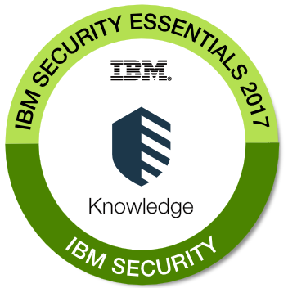
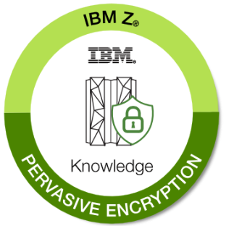

For more information …
IBM Z Security:
https://www-03.ibm.com/systems/z/solutions/enterprise-security.html
z/VM Security resources:
http://www.vm.ibm.com/security
Securing Your Cloud: IBM z/VM Security (SG24-7471), IBM RedBooks
http://www.redbooks.ibm.com/abstracts/sg248353.html?Open
Security for Linux on System z (SG24-7728), IBM RedBooks
http://www.redbooks.ibm.com/abstracts/sg247728.html?Open
Contact Information:
Brian W. Hugenbruch
IBM Z Security for Virtualization and Cloud
bwhugen at us dot ibm dot com @Bwhugen

